Slide 1
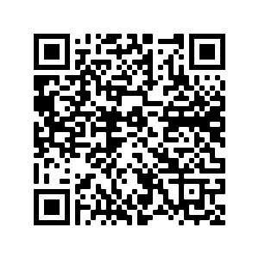
Schoology & Infinite Campus Parent Set Up

Slide 2
Infinite Campus
Parent Account Set Up Directions

Slide 3
Schoology
Parent Account Set Up Directions

Slide 4
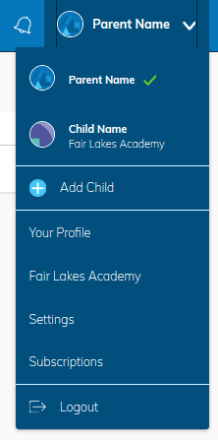
Accessing Student View in Schoology
Click on the drop down menu at the top right corner of the screen
You should now see your name and your student(s) name(s) below your name.

Slide 5
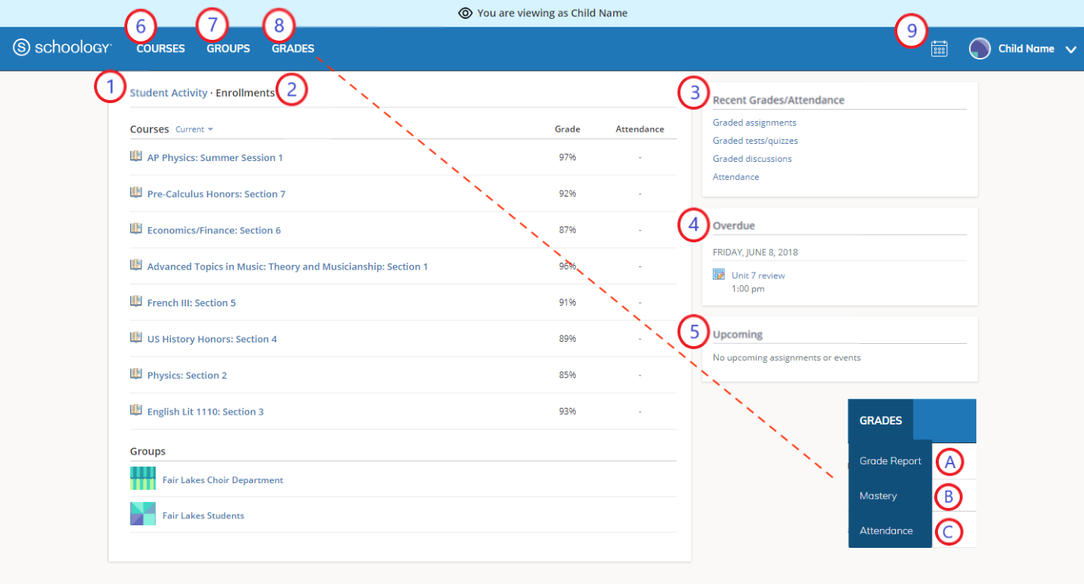
Viewing Student Grades in Schoology (Parent View)

Slide 6
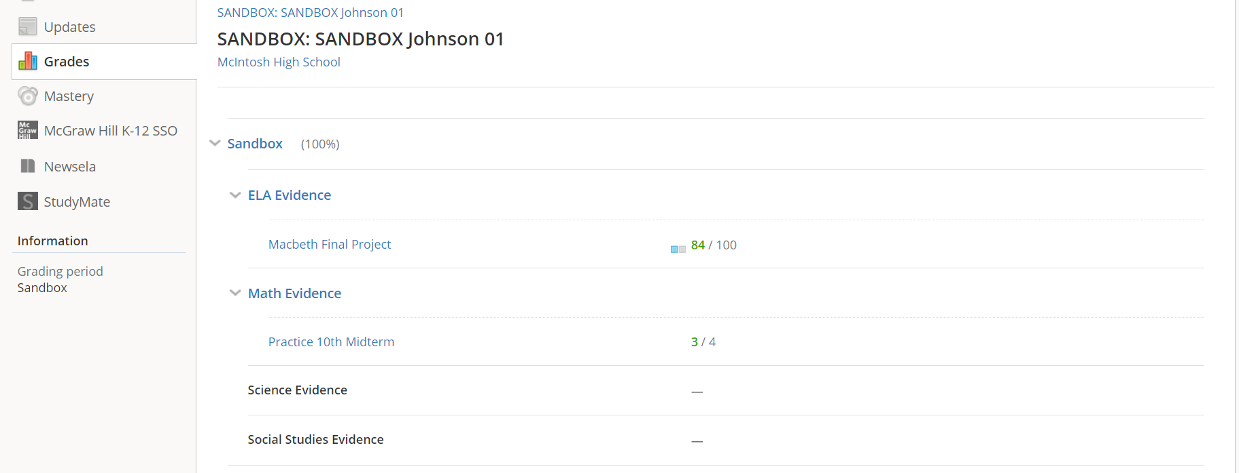
Viewing Student Grades in Schoology

Slide 7
Viewing Missing Student Grades Schoology (Parent View)

Slide 8
Viewing Calendar Schoology (Parent View)

Slide 9
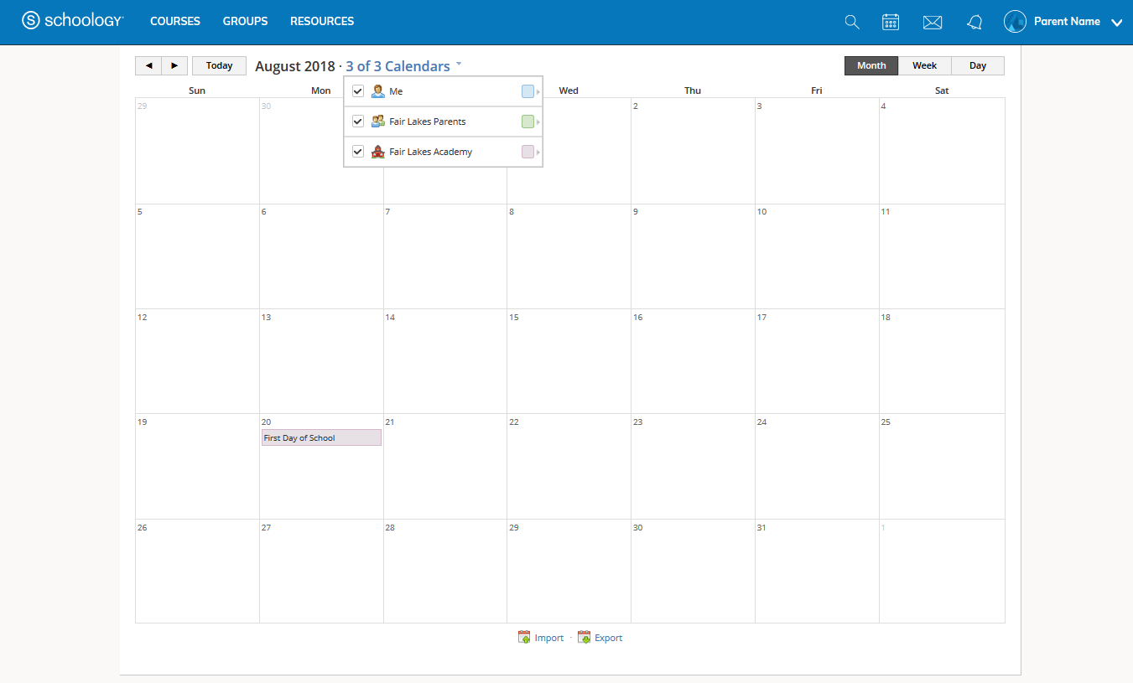
Viewing Calendar Schoology (Parent View)

Slide 10
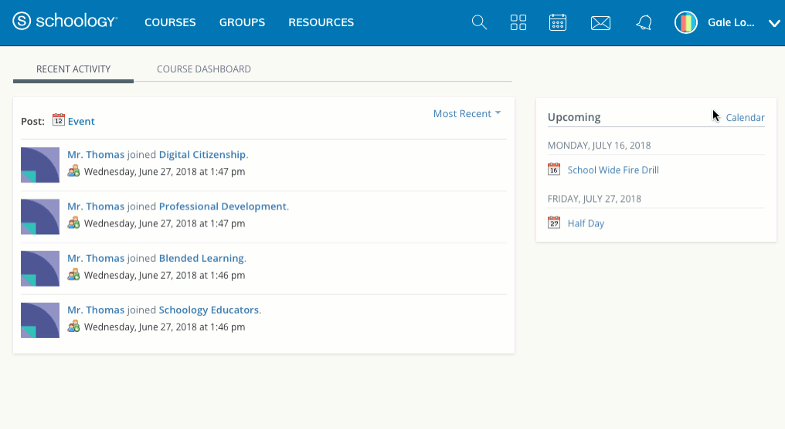
Managing Notifications in Schoology

